Slide 1
The FOODITY Data Lake
20-11-2024
Softeam
Fadwa REKIK
Amina MOUSSAOUI
Alessandra BAGNATO
Laurent GONCALVES

Slide 2
Table of contents
Foodity Datalake
01
Available services
Responsibilities and GDPR Compliance
02
Demo
03
04
Questions

Slide 3
Foodity Datalake
Where data meets delight!

Slide 4
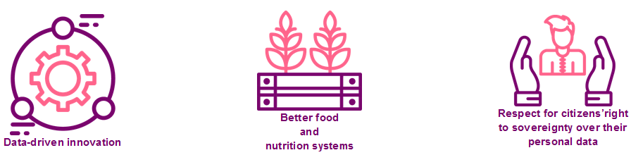

What is Foodity Datalake?
A platform dedicated to sharing and publishing datasets related to food and nutrition.
Foodity datalake is not a database for the data provider applications.

Slide 5
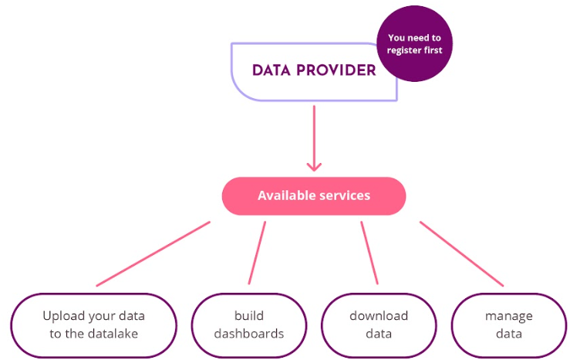
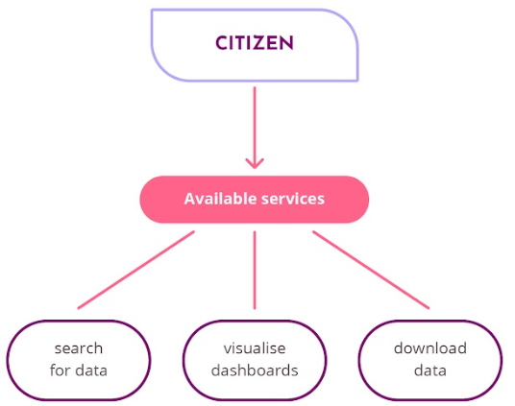
Data provider portail
Citizen portail
Available services
Available services

Slide 6
Current Dataset License Proposals
We offer 4 choices
1. CC0 1.0 (Creative Commons Zero 1.0 Universal) (3):
  This license provides the most open use of data: Ideal for maximizing data accessibility and reusability.
  Data under CC0 is essentially placed in the public domain and can be used without any restrictions.
2. CC-BY 4.0 (Creative Commons Attribution 4.0 International) (as default license) (2):
  Default license in Zenodo
  It allows others to use, modify, and share the data as long as they provide appropriate attribution (1).
  Often used in open data initiatives and research projects.
3. ODbL (Open Data Commons Open Database License)(4):
  ODbL is designed for open databases and provides strong copyleft protection.
  It requires derivative works to be released under the same open terms.
  Suitable for ensuring data remains open and freely available.
  4. CC BY NC ND (Creative Commons Attribution-NonCommercial-NoDerivatives)
  This license prohibits commercial use of the data and does not allow derivative works to be made. Users are required to provide attribution.

Slide 7
Responsibilities and GDPR Compliance

Slide 8
Responsibilities and GDPR Compliance
Protect personal and sensitive data
Your role: Data Controller
  You, as the data provider, are the Data Controller.
  FOODITY acts as a data processor.
Data Sharing:
  Public dissemination on the FOODITY website for citizen access.
  Data uploaded on the FOODITY site will be shared on EOSC (European Open Science Cloud - EU Node).
GDPR Principles Apply:
  From data collection to processing to publication, you should adhere to GDPR principles (anonymization, transparency, data minimization ect.).
  Ensure compliance with regulations for data protection and privacy.
Your Responsibility:
  You assume all responsibility for the data you upload onto the FOODITY platform.
  Demonstrate GDPR compliance in all phases of data handling.

Slide 9
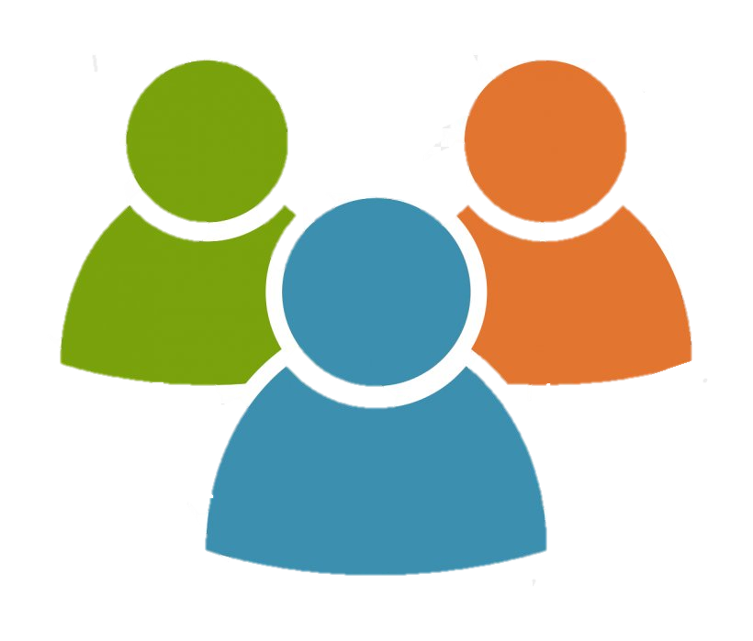



Before uploading your data
How to guarantee transparency and privacy?
Obtain User Consent via DataU: Before uploading any data to the public data lake, it is crucial to use DataU to ensure that individuals are fully informed and give explicit consent regarding how their data will be handled. The consent must clearly state that the data will be anonymized before being shared in the FOODITY public data lake for research purposes.
Anonymization : Once consent is collected, anonymization should be applied to the data as an added layer of privacy protection.
Anonymisation
DataU Consent
privacy
transparency
End users
Pilot App
FOODITY Data lake
Notes:
Users must give explicit consent, even if the data will be anonymized at a later stage. This guarantees transparency, as users will understand how their data will be processed and shared.
This two-step process—consent followed by anonymization—ensures both transparency and privacy. While the data will not contain identifiable personal information, DataU ensures that users are aware of the collection, the anonymization process, and the purpose for which their data is being used.

Slide 10
Demo
How to upload data to the Datalake?

Slide 11
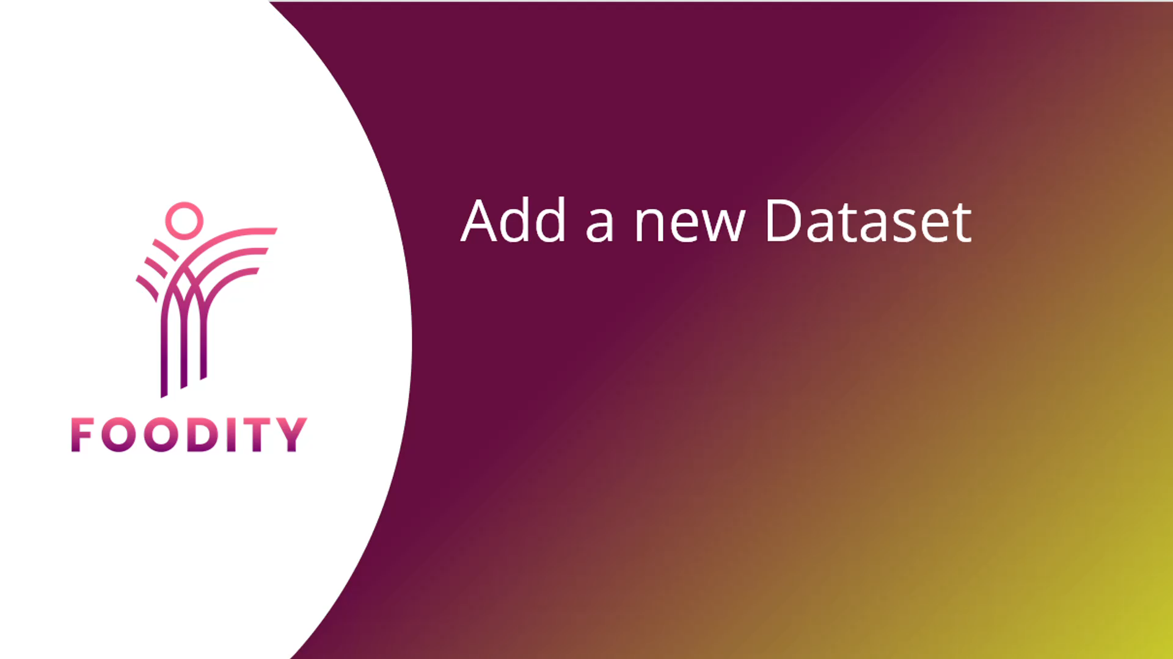

Slide 12
Demo
FOODITY Data Lake/ Dashboards

Slide 13
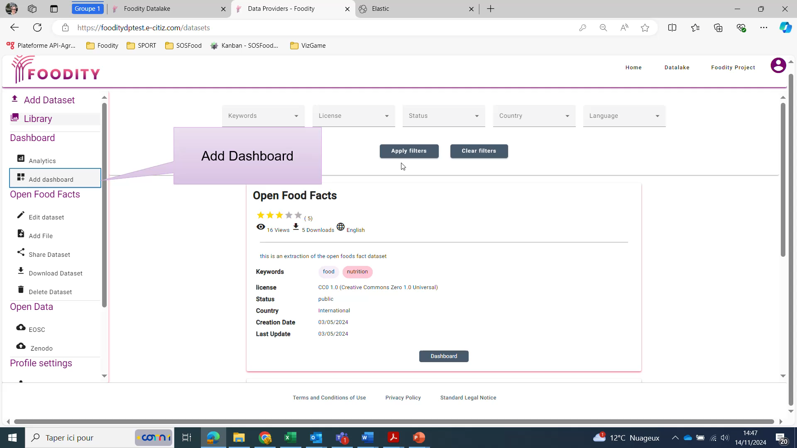

Slide 14


@FOODITY_EU
/foodity-eu

Slide 15
Demo
Registration and Validation

Slide 16
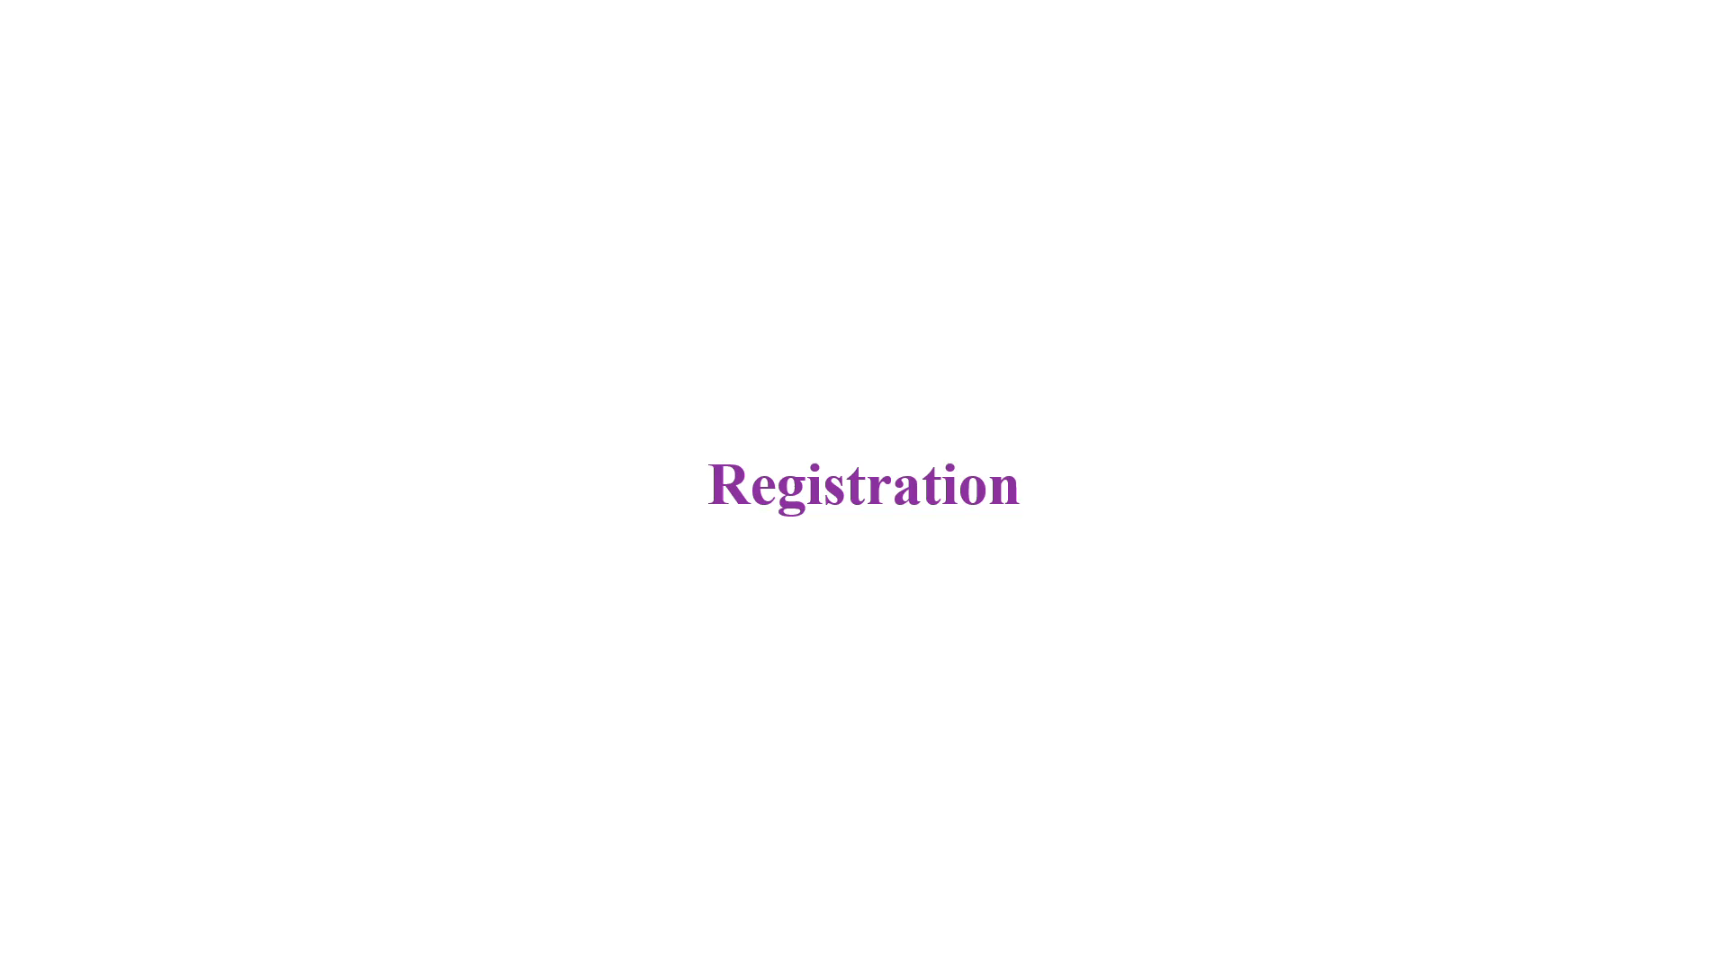

Slide 17
Anonymisation
Guidelines
1. User Identification: be sure that there are no identifiers; anonymize user-related information (Exclude phone numbers, email addresses, or any personal contact details)
2. Geolocation Information: Provide only general location information; exclude specific addresses.
3. Demographic Information: Use anonymized demographic categories instead of specific user attributes (e.g. age ranges, such as 18-24, and 25-34 instead of specific age).
4. Meal Plans and Dietary Tracking: Exclude personally identifiable details related to meal plans, dietary preferences, or weight goals; anonymize or aggregate the information.
5. Free-Text Comments: exclude any free-text comments, open-ended responses, or unstructured text fields.
Notes:
Before uploading your data to the datalake you need to follow these privacy Guidelines

